Slide 1
Divvy Bikes
Optimising the Fleet of Bicycles

Slide 2
Divvy Bikes: Optimising the Fleet
About Divvy Bikes
About Divvy Bikes’ fleet of bicycles
The benefits that purchasing new bikes has delivered
Why Divvy should consider replacing more bikes

Slide 3
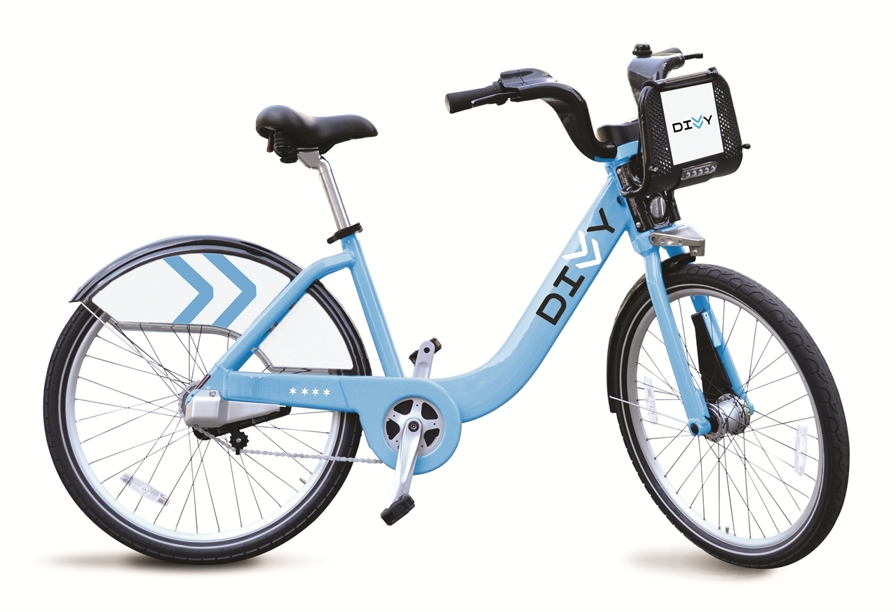
About Divvy Bikes
Chicago’s bike share system
Pedal-powered
610 dock stations

Slide 4
Size of the Fleet
6460 bikes in use from 2016-2019

Slide 5
When Bikes Were Introduced
5 distinct intakes

Slide 6
When Bikes Were Introduced
Multiple distinct intakes

Slide 7
When Bikes Were Removed
Concentrated in summer
Increasing over the years

Slide 8
When Bikes Were Removed
Concentrated in summer
Increasing over the years

Slide 9

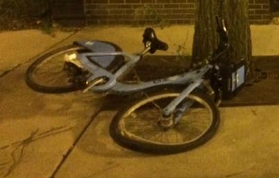
When Bikes Were Removed
Concentrated in summer
Increasing over the years

Slide 10
Why Bikes Were Removed
The dates that bikes were first used and last used are uncorrelated (0.039)
Not failing due to age

Slide 11
Rider Preference
Initially new bikes ridden twice as often on average
Effect decreases over time

Slide 12
Trip Speeds
New bikes average faster speeds

Slide 13
Trip Distances
Bike age has minimal effect on trip distances

Slide 14
Bike Relocations
Old bikes: A relocation every 12.0 trips
New bikes: A relocation every 17.5 trips

Slide 15
Considerations for the Future
New bikes are an up-front cost
Although not required for reducing bicycle failure
Deliver ongoing benefits:
Clear customer preference
Likely improve customer satisfaction
Opportunity to deliver improved product
Reduced service cost

